Slide 1

Movie Review
Presented by:
Ajay Das(202004), Dipesh Bohara (202009), Hiten Napit(202011), Nikesh Dhakal(202015)

Slide 2
INTRODUCTION
Seenema is a movie review website designed to simplify the process of discovering and choosing movies.
It will offer user a comprehensive overview of a movie.
User can browse through the movies with reviews and add their own reviews in the movies.
It will provide all the necessary information about the movies.

Slide 3
PROBLEM STATEMENT
With so many movies available on different platforms, there lacks a user-friendly platform for individuals to access reviews and contribute their own opinions.
Due to the lack of feedbacks and rants, moviegoers may feel bias about the selection of the movies.

Slide 4
OBJECTIVES
Develop a user-friendly platform for sharing and discussing movie reviews.
Enable the functionality for users to submit reviews on movies.
Provide the capability for users to respond to existing reviews.
Implement a system to filter and remove any inappropriate comments to ensure a respectful and constructive community.

Slide 5
SCOPE
Seenema serves as a go-to platform for movie enthusiasts to make informed decisions about what to watch next through online connection, leveraging user-generated content and reviews.
It contributes to understanding social influence dynamics and digital media consumption patterns, showing us how people's taste in entertainment is changing.

Slide 6
LIMITATION
Seenema effectiveness relies heavily on user participation and the quality of reviews, which may vary in reliability and relevance.
Seenema's influence may be limited to Nepali movies and limits of added foreign movies.
Seenema's focus on movie reviews may limit its scope, potentially overlooking other entertainment sectors like TV shows or music.

Slide 7
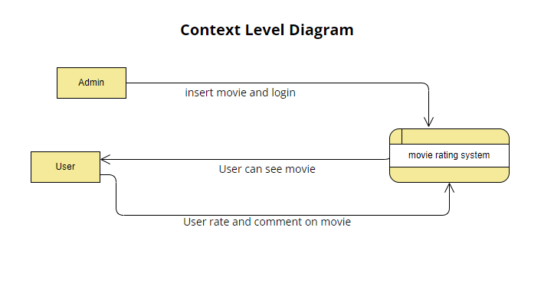
PROCESS METHOD

Slide 8
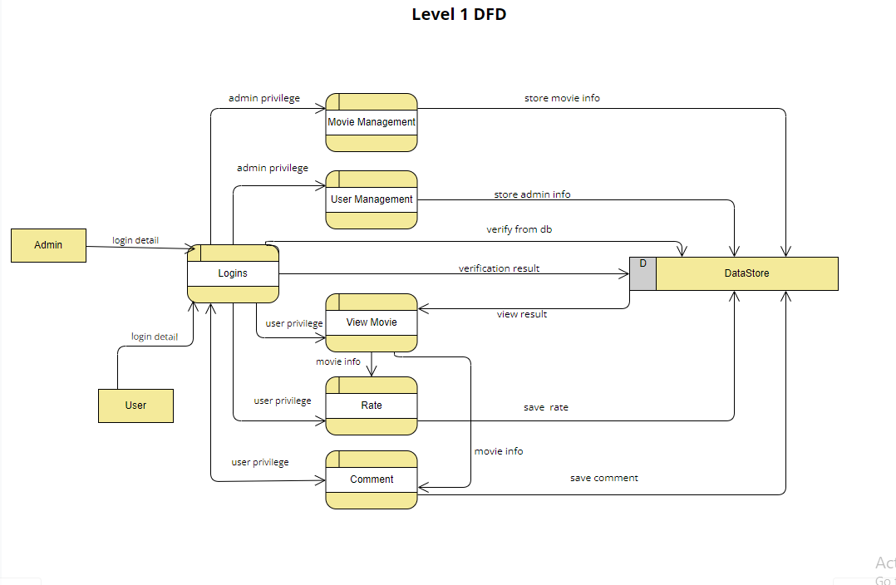
PROCESS METHOD

Slide 9
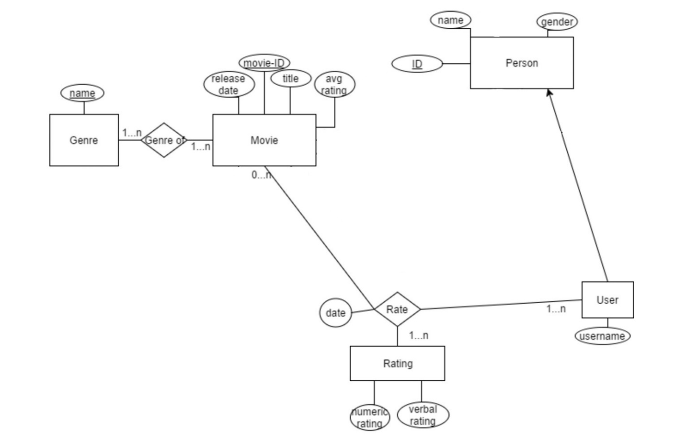
ER DIAGRAM

Slide 10
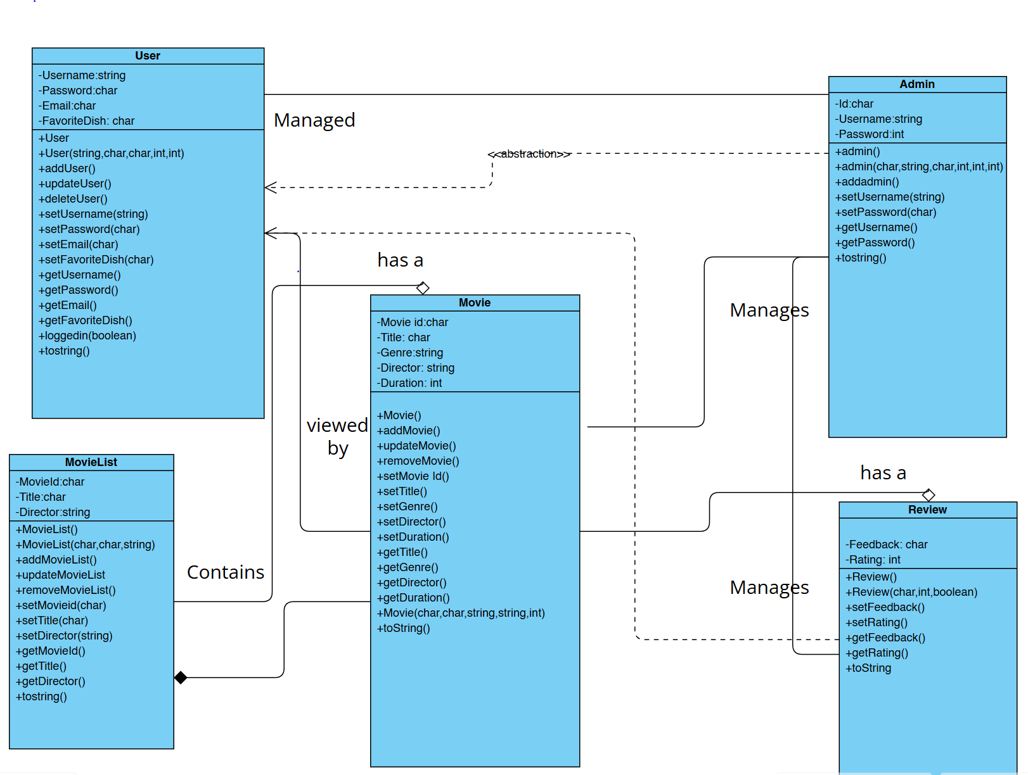
CLASS DIAGRAM

Slide 11
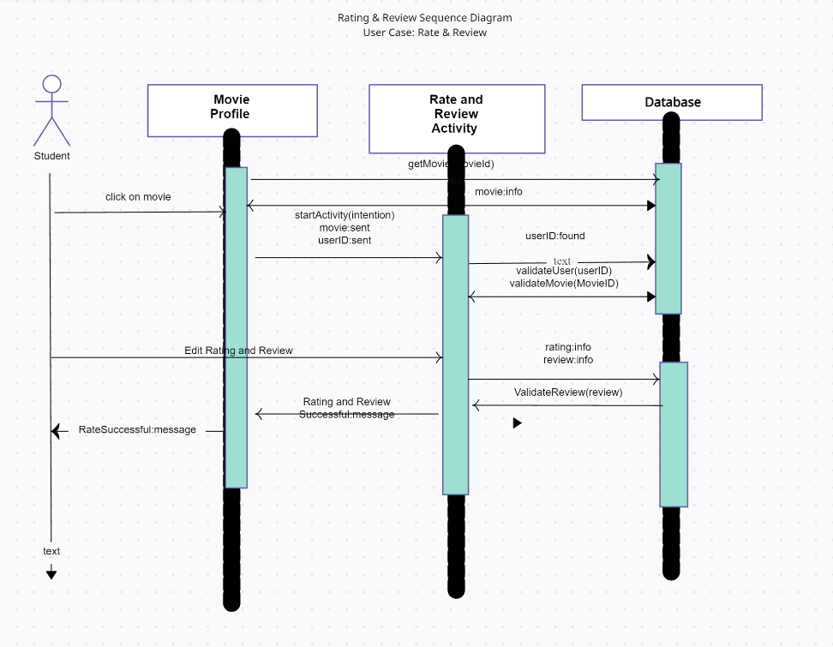
SEQUENCE DIAGRAM

Slide 12
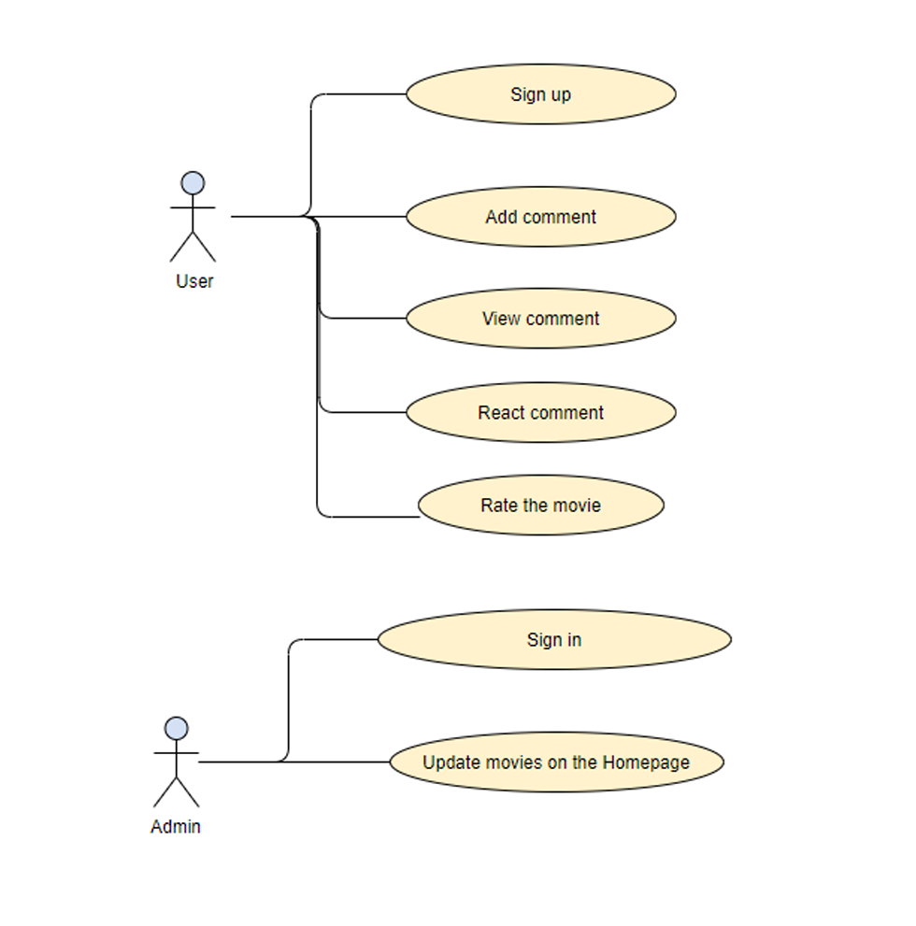
USE CASE DIAGRAM

Slide 13
OUTPUT AND DELIVERIES
Shows Multiple Movie Review: Upcoming Movies, Movie review and Description are Updated by the Developer.
User Interaction: User can Rate the Movies, Comment and Reply to comment, User can react to Comment.
User friendly Experience: User cannot use vulgar words in the comment.

Slide 14
CONCLUSION
In conclusion, movie review web applications play a crucial role in film enthusiasts’ lives. It brings together user reviews to create a dynamic community where everyone can share their thoughts on films.

